Slide 1
This presentation is part of the lesson plan:
Seven For A Minyan – November 30th – The Day Marking the Departure and Expulsion of the Jews from Moslem Countries
The Exodus of the Jews of Moslem Countries
For hundreds of years, the Jews lived in most Moslem countries in large, vibrant communities. In the years prior to the establishment of the State of Israel, and particularly between the years 1948 and 1969, many Jews left. Some left of their own free will, immigrating to Israel or migrating to the countries of Europe or America, but many were expelled from their homes and from the countries in which they lived.
In the 1940’s, there were about one million Jews living in Arab countries and in Iran. Following their departure or expulsion, there remained in those countries less than twenty thousand people. Today there are only a few thousand Jews living in Moslem countries.

Slide 2
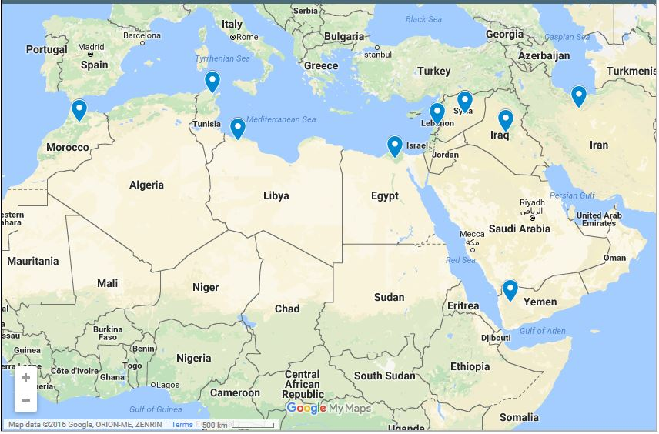
The Jewish Communities in Moslem Countries

Slide 3
The Jewish Population in Nine Countries of the Middle East and North Africa in the years 1948-1969
Country | 1948 | 1966 | 1969
Yemen | 45,000 | 2,000
Tunisia | 90,000 | 23,000 | 10,000
Iraq | 125,000 | 6,000 | 2,500
Syria** | 27,000 | 4,000 | 4,000
Egypt | 75,000 | 25,000 | 1,000
Morocco | 260,000 | 70,000 | 50,000
Libya | 40,000 | 6,000 | 100
Lebanon** |  | 6,000 | 1,000
Iran | 80,000 | 80,000 | 80,000
** Data for Syria for 1948 includes Lebanon as well

Slide 4
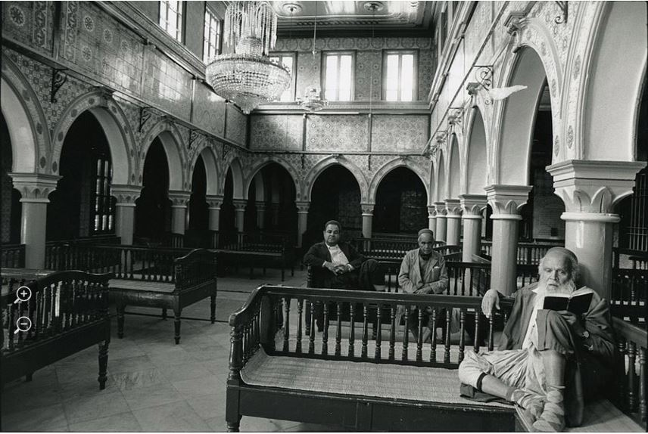
Looking at the Picture
Look at the picture and identify as many elements as possible

Slide 5
Picture Name | Seven For A Minyan
Photographer | Zion Ozeri
Location | El Ghriba Synagogue, Djerba, Tunisia
Date Taken | 1995

Slide 6
About the Picture
Seven For A Minyan, Djerba, Tunisia, 1995
This is the El Ghriba Synagogue, on the island of Djerba, in Tunisia. The present building was constructed in 1929, but there is a tradition among the Jews of Djerba that it was first built over 2,000 years ago, and that some of the stones used for building it had been brought from the destroyed Temple in Jerusalem.
In the picture, we see three men in the synagogue, and it is entitled “Seven For A Minyan,” since Judaism requires that there be ten Jews present to form a minyan, or quorum. A minyan of Jews is very important, since there are many mitzvot that cannot be performed without a minyan. When at least ten Jews come together, such a group can also be called a kehilah, a community. The Jews in the picture are among the last remaining members of the community in Djerba.
Will seven more Jews come to make up the minyan?

Slide 7
Based on the photograph and the texts that you have read, how, in your opinion, can the story of the Jewish communities in Moslem countries be told?
Is this a story of displacement and expulsion?
Is it one of Redemption and Aliya to the Land of Israel?
Is it even possible for us to say?
© Media rights:
Table – The Number of Jews in the Communities in the Years 48-69. Haim Saadon, Atzmaut VeGoral [Independence and Fate], 2011, p.9. Ministry of Education, Ben Zvi Institute for the Study of Jewish Communities in the East, Jerusalem.
Photograph – Seven For A Minyan – Zion Ozeri

Slide 8
Name
Iran
Description
The origins of the Jewish community in Iran date back to the Babylonian Exile, about 2,700 years ago. Major events in its history are a part of the history and culture of the Jewish people: for example, the Proclamation of Cyrus and the story of Megillat Esther. The Jewish community continued to exist in Iran even after the establishment of the State of Israel. In 1979 a radical Islamic revolution took place in Iran, and the majority of the Jews emigrated from Iran to Israel, the United States, and other countries.

Slide 9
Name
Iraq
Description
The Jewish community of Iraq is one of the most ancient Jewish communities. Its beginnings go back 2,700 years. Over the course of history, Iraqi Jewry was the leader of the Jewish people, and the major cultural assets of the Jewish people came into being there. The Jews had a good relationship with their Moslem neighbors, and had a major influence on the Iraqi culture and economy. The Jewish-Arab conflict in the Land of Israel, and Nazism in Europe, affected this relationship, and following the establishment of the State, the Jews left Iraq. Some fled in covert operations. In 1951 most of the remaining Jews immigrated to Israel in Operation Ezra and Nehemiah.

Slide 10
Name
Syria
Description
Jews had lived in Syria as far back as Biblical times. The population there increased following the Expulsion from Spain in 1492. The main Jewish centers were located in Damascus and Aleppo. Relative to its small size, the Jewish community had a major economic and spiritual influence. Jews from Syria emigrated to Jerusalem and to various places around the world, where they founded new communities.

Slide 11
Name
Lebanon
Description
Jews had lived in Lebanon from the days of King Herod, over 2,000 years ago. In 1492, following the Expulsion from Spain, the community grew, but it always remained rather small. During the first half of the 20th century, Jews from Greece, Turkey, Syria and Iraq migrated there.

Slide 12
Name
Egypt
Description
Jews had lived in Egypt from Biblical times. In the 19th and 20th centuries, many Jews migrated there, and in 1948 it numbered 80,000 members. The Jewish community in Egypt was known for the broad range of views, languages, and occupations carried out by its members.

Slide 13
Name
Libya
Description
The Jewish community in Libya came into existence about 2,300 years ago. In 1391, and again in 1492, Jews from Spain migrated there, bringing the Sephardic culture to the community. Most of Libya’s Jews left in 1951, after Libya obtained its independence.

Slide 14
Name
Tunisia
Description
The Tunisian community has existed for over 2,300 years. Major religious and spiritual leaders came from there, as well as leading international merchants. In 1881 Tunisia was conquered by the French, and the community grew, becoming active both politically and socially. When French rule weakened, the majority of the community’s members migrated to France or to Israel.

Slide 15
Name
Morocco
Description
The first Jews began to arrive in Morocco over 2,000 years ago. The community grew greatly as a result of the Expulsion of the Jews from Spain in 1492, at which time many Jews came to Morocco. Rambam, one of the most influential figures in Judaism, lived and was active in Morocco. The Jews of Morocco maintained strong ties to the Land of Israel over the centuries, with individuals and groups settling there, and forming a significant part of the Yishuv before the advent of Zionism. The first signs of modern Zionist activity began in the early 20th century, and with them came an increase in aliya from there. Anti-Jewish persecutions accelerated the rate of aliya. Following the establishment of the State of Israel, over 250,000 Jews made aliya from Morocco, while others migrated to the countries of Europe and North America, and particularly to France.

Slide 16
Name
Yemen
Description
It is believed that Jews first came to Yemen before the destruction of the First Temple (about 2,700 years ago). The Jews of Yemen lived mainly in the villages, in small communities. The Jews of Yemen maintained traditions that were prevalent in the Land of Israel thousands of years ago.

